Slide 1
The First or The Seventh?
What day does the Lord REQUIRE Christians to worship on?
Can we know for certain?
Notes:
Are we left to subjective thinking and feeling or can we know for sure which day the Lord “requires” us to worship on?

Slide 2
Sabbatarians Contend:
The Sabbath day was given to all men since the beginning of creation (Gen. 2:1-3; Ex. 20:8-11)
The Sabbath day was an everlasting command (Ex. 31:16, 17)
  Was written on stone to show its permanence (Ex. 31:18)
God changes not (Mal. 3:6)

Slide 3
We shall. . .
examine these passages
show to whom the Sabbath was given
establish authority for the first day of the week
Notes:
Next week we will answer the third part.

Slide 4
1 Thus the heavens and the earth, and all the host of them, were finished.
2 And on the seventh day God ended His work which He had done, and He rested on the seventh day from all His work which He had done.
3 Then God blessed the seventh day and sanctified it, because in it He rested from all His work which God had created and made
Genesis 2:1-3 (NKJV)
says God ended His work, doesn’t command anyone else to end theirs!
says God rested but doesn’t command anyone else to rest!
says God blessed and sanctified the seventh day but doesn’t command anyone else to bless and sanctify it!

Slide 5
Seventh-Day Adventists
DON'T RESPECT
"WHO"
IS BEING SPOKEN TO

Slide 6
“Then God blessed the seventh day and sanctified it, because in it He rested from all His work which God had created and made”
Genesis 2:1-3 (NKJV)
God SANCTIFIED the fiftieth year (Lev. 25:10)
  Are Gentiles and Christians required to?
God SANCTIFIED censers (Num. 16:37, 38)
  Were they to be holy to Gentiles and Christians?
  “. . . and they shall be a sign to the children of Israel” (v. 38)
Notes:
Sabbatarrians say that God sanctified it and therefore we should too.

Slide 7
The Only Commands In Genesis 2
TO ADAM
  tend the garden (2:15)
  eat every tree in the garden except tree of knowledge (2:16, 17)
  name the creatures (2:19)
TO ALL MANKIND
  leave father and mother. . .join to wife. . . become one flesh (2:24)
NO SABBATH COMMAND!
Notes:
The only command from Genesis 2 that remains binding today is the one regarding marriage?

Slide 8
QUESTIONS
Do Sabbatarians keep the command to tend the Garden of Eden?
  Why Not? . . .It was taken away!
Do Sabbatarians keep the command regarding Adam’s Diet?
  Why Not? . . .It was taken away!
  *They do bind Moses’ diet to abstain from pork. . .violates 1 Timothy 4:4, 5!
Why do we not keep the Sabbath command today?
  BECAUSE IT WAS TAKEN AWAY!
Notes:
CLICK X

Slide 9
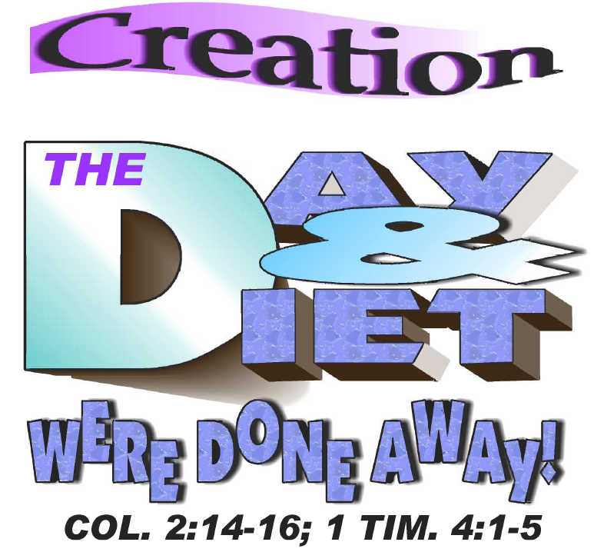
Notes:
The Creation day of rest as well as the diet that was commanded to Adam were done away in the New Testament!
Diet. . .“For every creature of God is good, and nothing is to be refused if it is received with thanksgiving; for it is sanctified by the word of God and prayer” (1 Tim. 4:4, 5)
Sabbath. . .[CLICK]

Slide 10
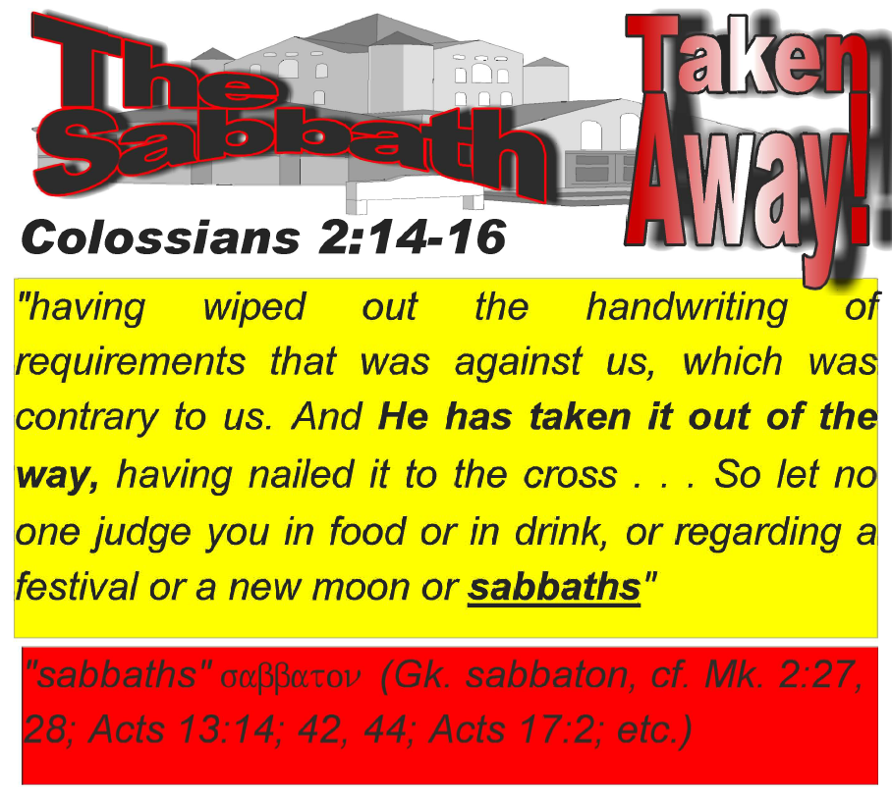

Slide 11
8 "Remember the Sabbath day, to keep it holy.
9 Six days you shall labor and do all your work,
10 but the seventh day is the Sabbath of the LORD your God. In it you shall do no work: you, nor your son, nor your daughter, nor your male servant, nor your female servant, nor your cattle, nor your stranger who is within your gates.
11 For in six days the LORD made the heavens and the earth, the sea, and all that is in them, and rested the seventh day. Therefore the LORD blessed the Sabbath day and hallowed it.
Exodus 20:8-11 (NKJV)
SDA Complaint: “The only command that God tells us to ‘remember’ is the one forgotten.”
SDA Contention: “For Israel to ‘remember’ means they must have been previously keeping it!”

Slide 12
“Remember”
Who was told to “remember the Sabbath” in Exodus 20?
  The church? NO
  Gentiles? NO
  Israel? YES
An observation:
If Sabbath days were being observed by all men/nations since the creation, why would God have to tell Israel to remember it!
Notes:
Who is to remember (click through) - "the people" (v. 18). . .what people?. . .children of Israel (v. 22).

Slide 13
“Remember”
the command to “remember” doesn’t necessitate that the action was always being done
  “And Moses said to the people: ‘Remember this day in which you went out of Egypt, out of the house of bondage; for by strength of hand the LORD brought you out of this place. No leavened bread shall be eaten’” (Ex. 13:3, NKJV)
    was the Passover being kept before this? NO!
    but were they to remember that day? Yes!

Slide 14
“Remember”
simply conveys:
  to bring to mind; to keep in memory
  “And you shall remember the LORD your God, for it is He who gives you power to get wealth, that He may establish His covenant which He swore to your fathers, as it is this day” (Deut. 8:18, NKJV)
  “Remember now your Creator in the days of your youth. . .” (Eccl. 12:1, NKJV)

Slide 15
16 Therefore the children of Israel shall keep the Sabbath, to observe the Sabbath throughout their generations as a perpetual covenant.
17 It is a sign between Me and the children of Israel forever; for in six days the LORD made the heavens and the earth, and on the seventh day He rested and was refreshed.
Exodus 31:16, 17 (NKJV)
To Whom was the Sabbath given?
  ISRAEL
To Whom was the Sabbath a sign between?
  GOD & ISRAEL
How long is “FOREVER”?
  THROUGHOUT THEIR GENERATIONS (LIMITATION)
  PERPETUALLY
Notes:
CLICK THROUGH

Slide 16
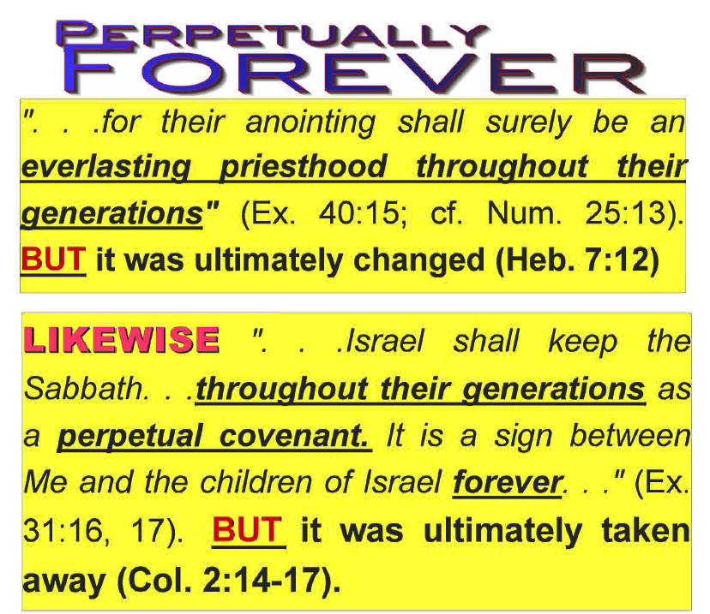
Notes:
Aaron’s sons were to be priests perpetually throughout their generations. It was to be an everlasting priesthood, yet, the “everlasting” was to be understood by the limitation of the phrase, “throughout their generations.”
If we can accept the New Testament when it teaches that the priesthood was changed, then why can we not accept the New Testament when it states that the Sabbath had been taken away?

Slide 17
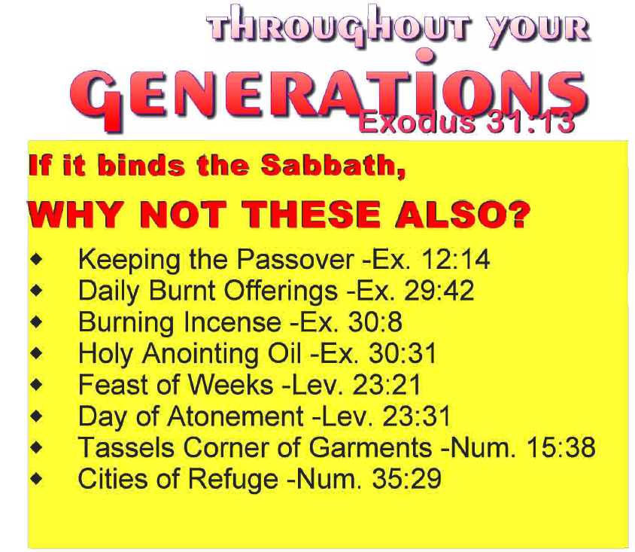
TEMPORARY

Slide 18
Seventh-Day Adventists
DON'T RESPECT
"WHO"
IS BEING SPOKEN TO
Notes:
The Sabbath was given to Israel, not the SDA
The Sabbath was to be kept throughout their generations, not throughout the SDA’s
The Sabbath was a sign between God and Israel (Ex. 31:17). Did you catch that? A sign between God and one nation, Israel! How can it be contended that the Sabbath was given to all nations it if was a sign between God and Israel?

Slide 19
And when He had made an end of speaking with him on Mount Sinai, He gave Moses two tablets of the Testimony, tablets of stone, written with the finger of God
Exodus 31:18 (NKJV)
SDA Contention: “Sabbath was written in stone by God—made permanent”
Paul said what was written on stones passed away!
  “⁷ But if the ministry of death, written and engraved on stones, was glorious, so that the children of Israel could not look steadily at the face of Moses because of the glory of his countenance, which glory was passing away. . . ¹¹ For if what is passing away was glorious, what remains is much more glorious. . . ¹³ unlike Moses, who put a veil over his face so that the children of Israel could not look steadily at the end of what was passing away. ¹⁴ But their minds were blinded. For until this day the same veil remains unlifted in the reading of the Old Testament, because the veil is taken away in Christ” (2 Cor. 3:7, 11, 13, 14, NKJV)
Notes:
Read entire text. . .
What is the ministry of death? That which was engraved on stones! Moses gave it and that had a glory, but there is a better glory with the ministration of the spirit.

Slide 20
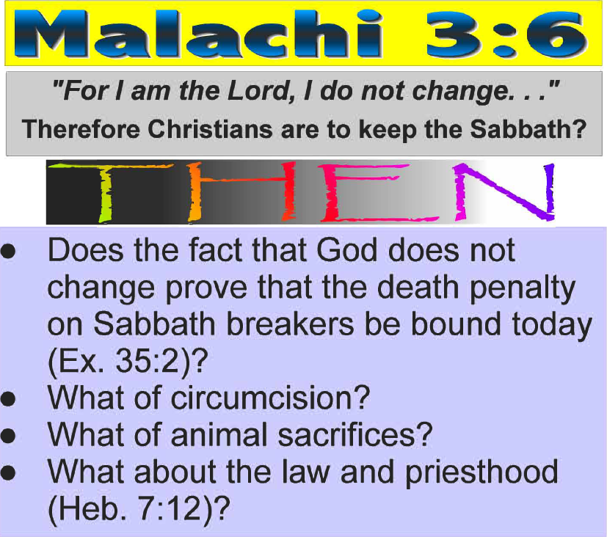
For I am the LORD, I do not change; Therefore you are not consumed, O sons of Jacob.
Malachi 3:6 (NKJV)
SDA Contention: “God gave the Sabbath; God doesn’t change; therefore the Sabbath is still binding today!”
THEN
Notes:
God is speaking about his ability to keep his promise. Israel had tested Him, yet God's immutable plan was for the Messiah to come through the Jacob and therefore He did not completely consume the Jacob (euphemism for children of Israel).

Slide 21
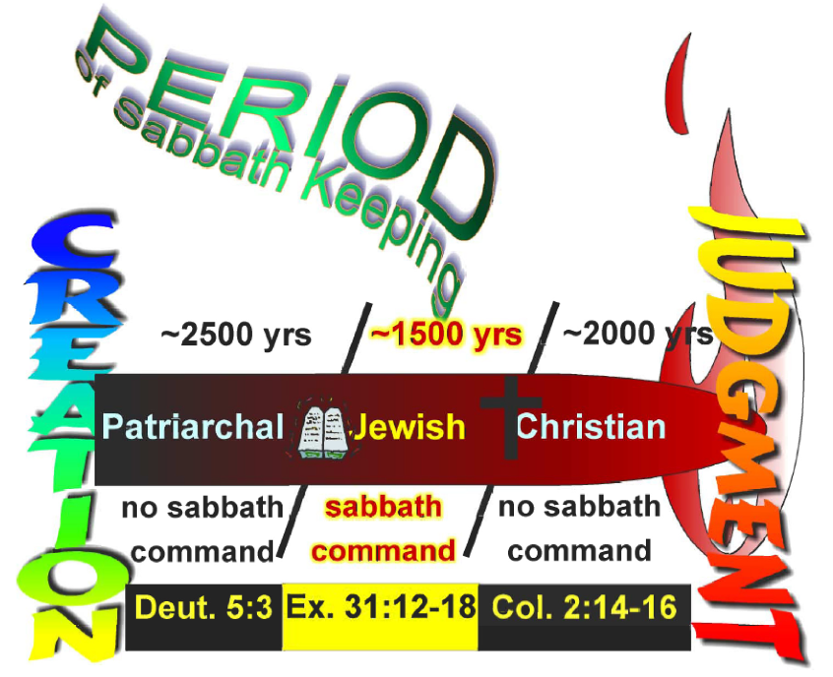
Notes:
Read Deut. 5:3, 12

Slide 22
THE PLAN FOR
YOUR SALVATION
1. Hear the Word of God---Rom. 10:17
2. Believing In Your Heart---Rom. 10:9; Acts 8:37
3. Repenting Of Your Sins---Acts 2:38
4. Confess That Christ Is The Son of God---Rom. 10:10; Acts 8:37
5. Be Baptized Into Christ---Gal. 3:26-29
6. Be Faithful Until Death---Rev. 2:10; I Cor. 15:58

Slide 23
Why The First Day of The Week?
THE DAY Jesus arose from the dead, “Now when He rose early on the first day of the week. . .” (Mk. 16:9, NKJV)
THE DAY a living hope was established, “Blessed be the God and Father of our Lord Jesus Christ, who according to His abundant mercy has begotten us again to a living hope through the resurrection of Jesus Christ from the dead” (1 Pet. 1:3, NKJV)

Slide 24
Why The First Day of The Week?
THE DAY Jesus was declared to be the Son:
  “I will declare the decree: The LORD has said to Me, ‘You are My Son, Today I have begotten You” (Ps. 2:7)
  “and declared to be the Son of God with power according to the Spirit of holiness, by the resurrection from the dead” (Rom. 1:4)
THE DAY Jesus appeared to His disciples (Jn. 20:1, 19)

Slide 25
Why The First Day of The Week?
THE DAY when the risen Savior was first worshipped (Matt. 28:1, 9, 10)
THE DAY Jesus revealed Himself to his disciples through the breaking of bread (Lk. 24:1, 13-15, 30, 31, 35).
THE DAY the disciples came together (Jn. 20:19, 20; Acts 20:7)
THE DAY the disciples gave of their means (1 Cor. 16:1, 2)
Notes:
RE: 1 Cor. 16:1, 2 -- Dugger tried to answer Porter that this was mere literal fruit that the some brethren were to go out and harvest for the brethren in Judea and was no special treasury of the church. He argued that they met on Saturday and were not allowed to work and therefore had to go out on the first day of the week to harvest this fruit to give to Paul (cf. Rom. 15:25-28, emp. "fruit" v. 28).
If that is the case, why would Paul care about what day it was that they were to harvest for the brethren?
Further, if Dugger is going to take "fruit" literally, then Paul must have been a canner too, because he "sealed" it. I wonder how much literal fruit a Paul and seven men (eight if you include Luke; Acts 20:4) could carry and how much good that would do the poor in Judea?
We know that it was money. . .that these brethren were laden with money is evident by what was spoken by Paul and what was understood by Felix (cf. Acts 24:17, 26).

Slide 26
Why The First Day of The Week?
THE DAY of Pentecost (firstfruits), “And ye shall count to you from the next day after the sabbath, from the day that ye brought the sheaf of the wave offering; seven sabbaths shall be complete: Even to the next day after the seventh sabbath shall ye number fifty days; and ye shall offer a new meat offering to the LORD” (Lev. 23:15, 16, Revised Webster)
  Jesus baptized with the Holy Spirit on the first (Acts 2:1-4, 33)
  The church was established on the first (Is. 2:2-4; Acts 2:41, 47)
  Many were added to it on the first (Acts 2:47)
  The first gospel sermon was preached, after the Lord’s ascension, on the first (Acts 2)
  The New Law went into effect (Is. 2:3; Lk. 24:47, 49, Acts 2:1ff)

Slide 27
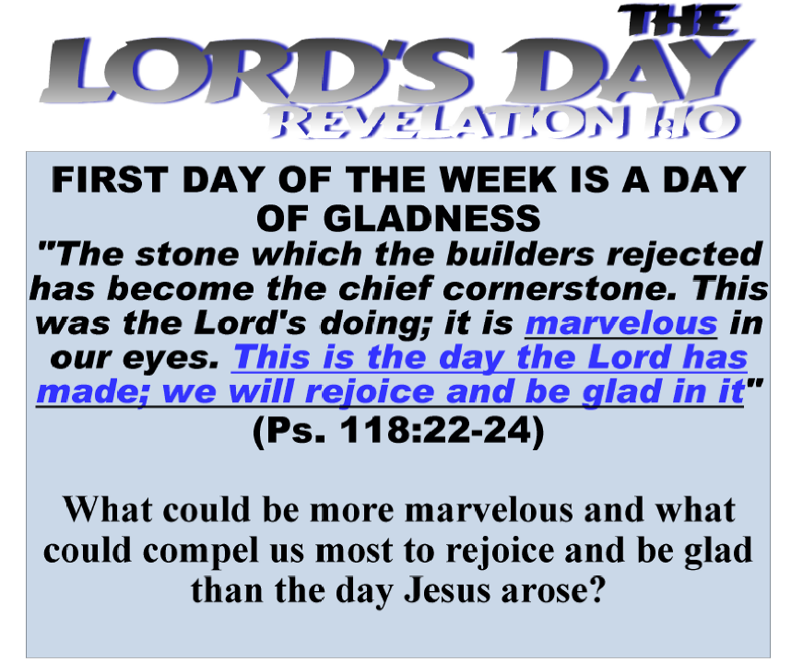
Notes:
After all that we have submitted, how can you go home today and think that Saturday is the Lord's day? How?
Some will say, He is Lord of the Sabbath. But read it more carefully:
Mr 2:28 "Therefore the Son of Man is also Lord of the Sabbath.“ NOTE “ALSO”
Lu 6:5 And He said to them, "The Son of Man is also Lord of the Sabbath.” He is “also” Lord of the Sabbath, that means that he is also the Lord of any other day of the week. He is Lord of all the days including the Sabbath. But John is not speaking of the Sabbath when he says “Lord’s Day” (Rev. 1:10).
What is the day the Lord has made for us to rejoice and be glad in???

Slide 28
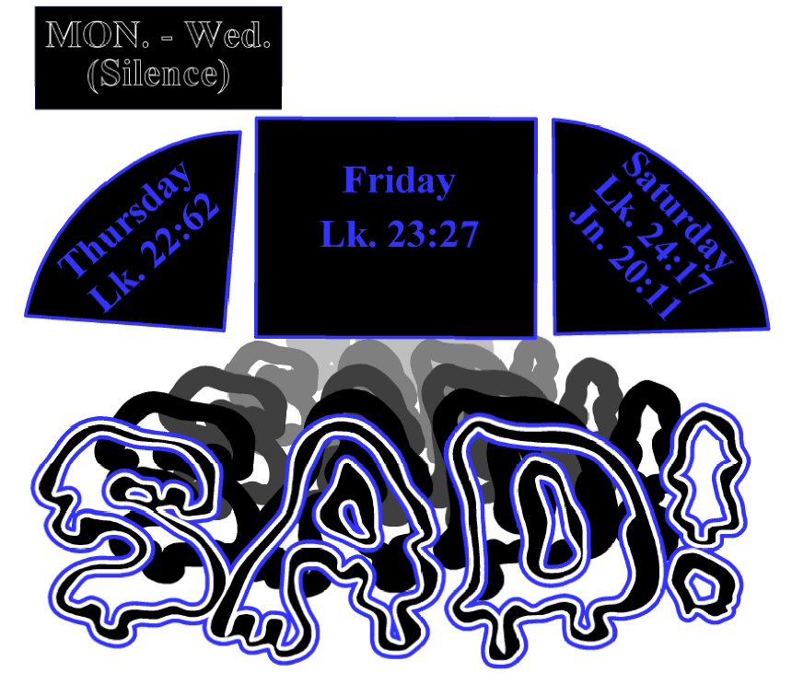
THURSDAY
FRIDAY
SATURDAY
LK. 22:62
LK. 23:27
LK. 24:17

Slide 29
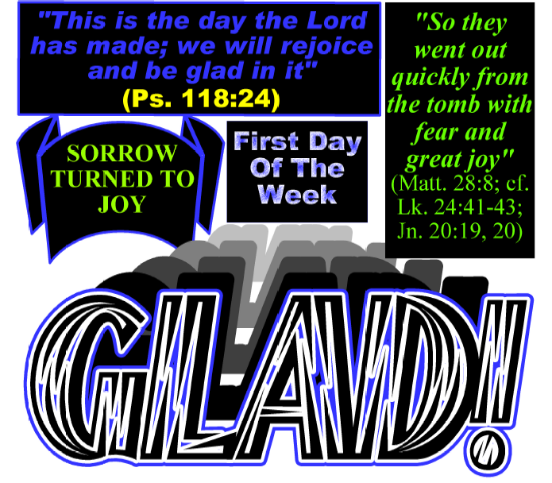
Notes:
"But while they still did not believe for joy, and marveled, He said to them, "Have you any food here?" Lk. 24:41

Slide 30
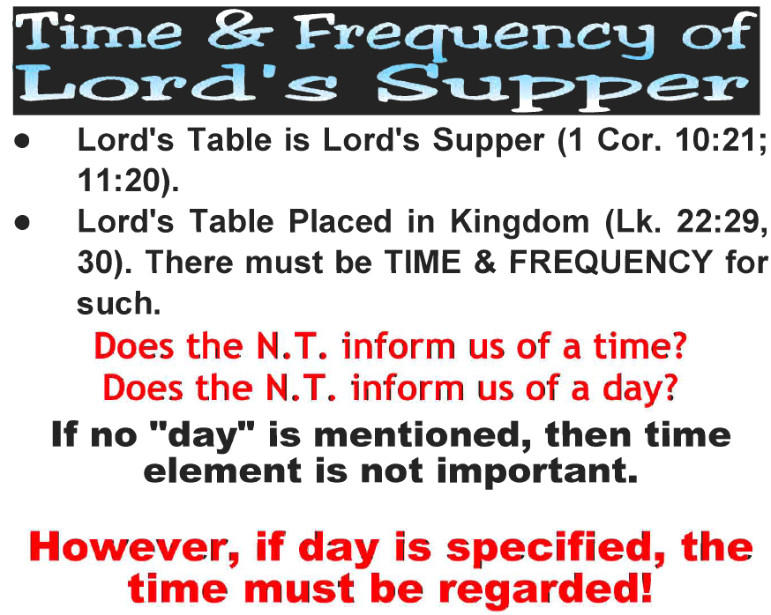
Notes:
1 Cor. 10:21 "You cannot drink the cup of the Lord and the cup of demons; you cannot partake of the Lord’s table and of the table of demons."
1 Cor 11:20 "Therefore when you come together in one place, it is not to eat the Lord’s Supper."
Lk. 11:29, 30 "And I bestow upon you a kingdom, just as My Father bestowed one upon Me, that you may eat and drink at My table in My kingdom, and sit on thrones judging the twelve tribes of Israel."

Slide 31
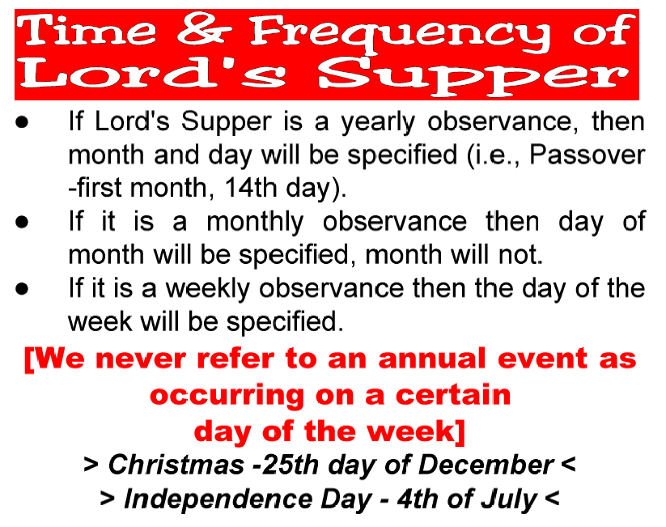

Slide 32
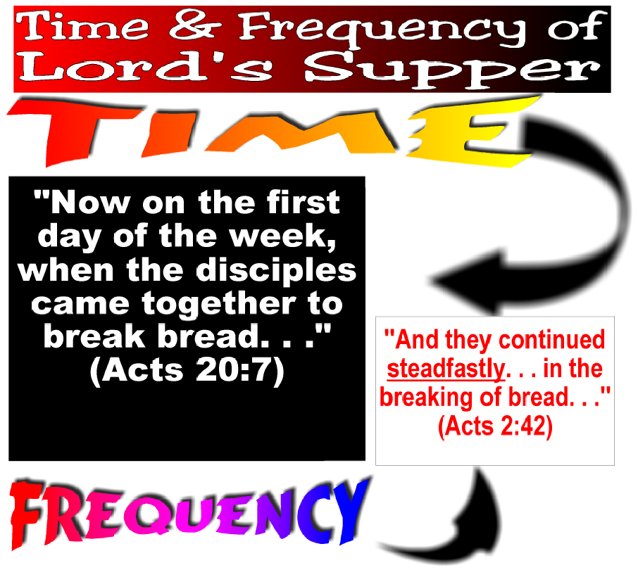
Notes:
Time and frequency of Lord's Supper tells us when the Lord's Table is to be observed.

Slide 33
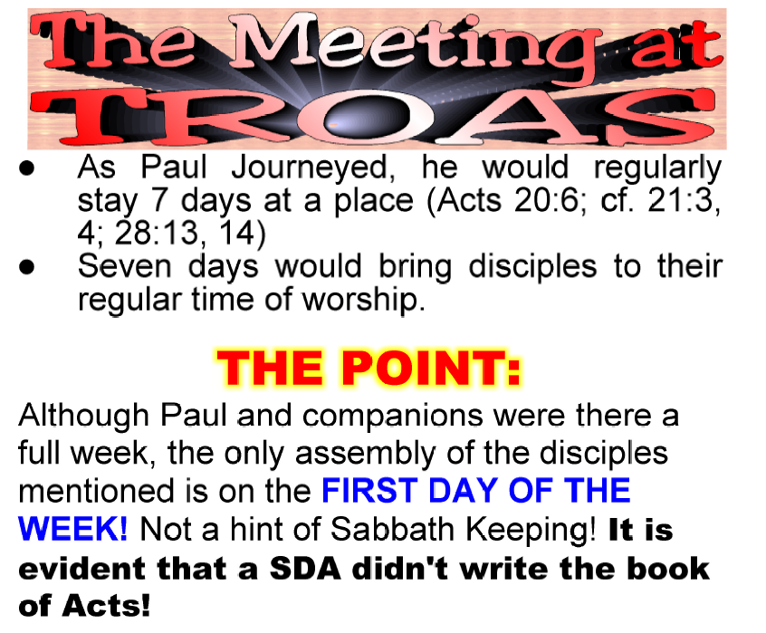

Slide 34
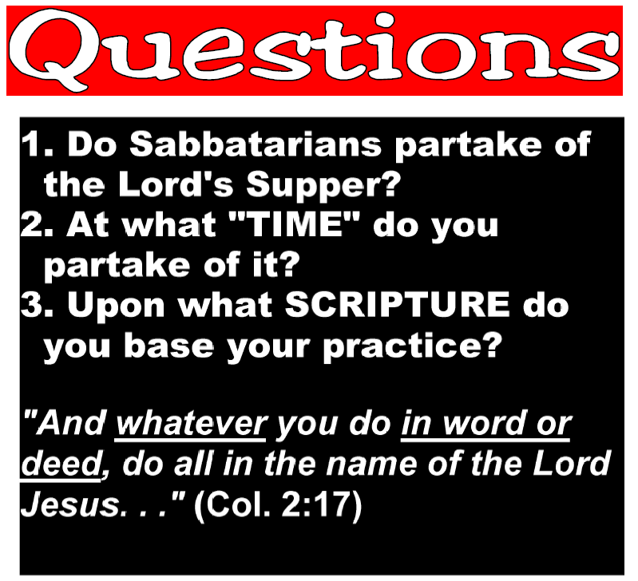
“And whatever you do in word or deed, do all in the name of the Lord Jesus, giving thanks to God the Father through Him”
(Col. 3:17)

